Slide 2
Agenda
Introductions
COC
Suncityaz.org
Important Dates
BP 12 Updates
Miscellaneous Forms
Club Room Safety
Publicity
Questions

Slide 3
COC - Club Organization Committee
The COC was formed as a support for club members
  They can help clubs with rules and regulation changes
  They can assist with club member disciplinary issues
  They will make suggestions on what policy changes are needed
Each club has a COC team assigned to them

Slide 4
suncityaz.org

Slide 5

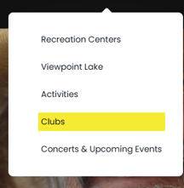

Slide 6





Rebuilding Club Webpages
-Summary
-Pictures
-Contact
-Dates/times/location
-Meeting Schedule
-Club Officer
-Acquisition/Disposal
-Reciprocal Events
-Sanctioned Events
Current Board Policy
Blank set up forms
Tool to check members RCSC Status
Notes:
Club forms – not listed attendance and financial – they are specific to the club

Slide 7
Important Dates
Annual Financial Statements
  Emailed at the end of December to Treasures and Presidents
  The beginning balance is filled in for you based on what we received as your ending balance the previous year.
  Donation Line
Treasurer 990N-Postcard
  990N-Postcard earned less than $50,000 prior to expenses
  Treasurer Class – How to File 990N Postcard

Slide 8
Club Roster
Anderson, Lou | 123456
Anderson, Mary | 123457
Burns, Janet | 45678
Burns, Mike | 45677
Campbell, June | 489
Campbell, Philip | 488
Dearborn, Winnie | 9247
Johnson, Brad | 901100
Miller, Mark | 33516
Nelson, Fred | 14555
Nelson, Wilma | 14556
Payne, John | 13687
Olsen, Joseph | 11497
Olsen, Margaret | 11498
Stewart, Joanne | 16951
Stewart, Thomas | 16952
Tapia, Jose | 14589
Tapia, Maria | 14590
Williams, William | 16520
Due March 1st and October 1st
Excel Format
  Not in PDF
  No wrapped columns
  No hidden columns/rows
  No miscellaneous information (phone number, email or years active)
Column A
  Last Name, First Name
    No nick names
    No quotes, hyphen, parentheses or apostrophes
Column B
  RCSC Number

Slide 9
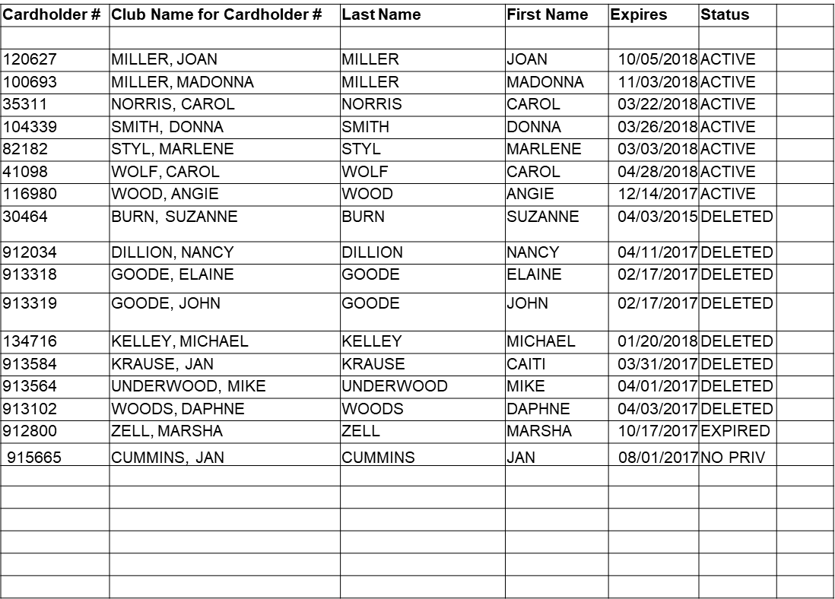
Returned Roster
If you receive members that say "DELETED", "INVALID" OR "NO PRIVILEDES" listed in the "status" column
Identification number was transposed
Identification number changed due to the member moving
Accidently identified as a member when they were a visitor or a guest.
Notes:
Please do not tell your club members they were deleted or invalid. Just ask to see their card or send them to member services to have it checked.
You do not need to send anything back to the club office. This is for your information and to correct before the next roster is due.

Slide 10
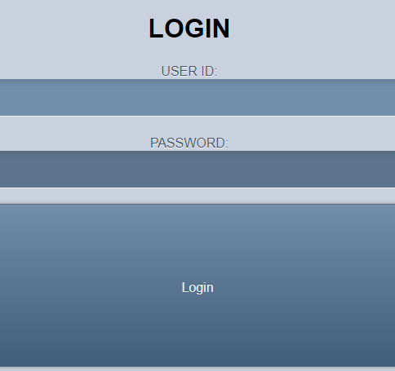
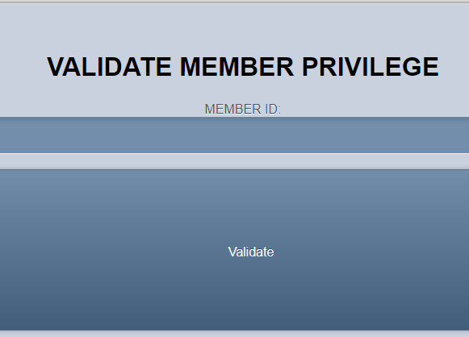
Member Validator
Notes:
You can check your members RCSC numbers through the member validator.
Each club has a username and password for using the validator.
If you do not have it send us an email and we can send it to you.
Once you have login type in the members RCSC number
You will get a red for members that do not have privileges and Green for those that do.
Many clubs do this for new members joining. The only downfall is you must be on RCSC internet to use this feature.

Slide 11
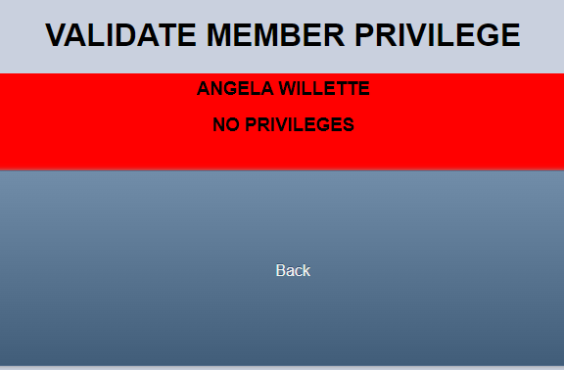
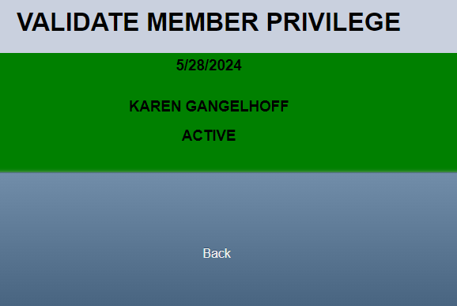
Validator Results

Slide 12
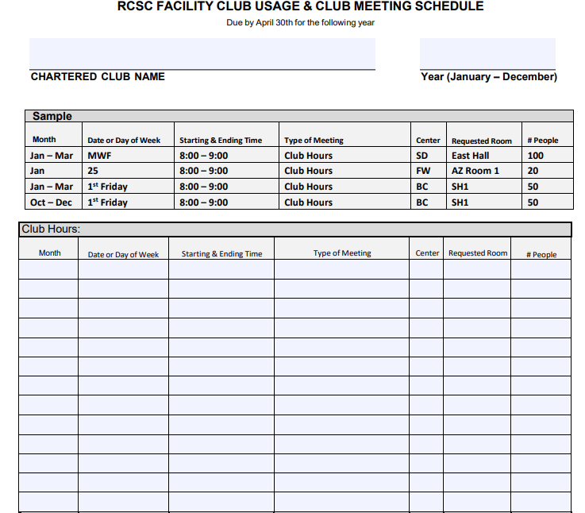
Meeting Schedule
2026 forms due prior to April 30th
Club Hours/Setup/Decoration times
Requirements
– (2) Board and (1) Membership Meetings
Scheduling Conflicts
-Call and Email
Adding/Canceling a Meeting
No Show Fee
Notes:
2026 Submitted prior to April 30th
2. Required to have
Two Board Meetings
One Member Meeting
3. Setup time
if you require setup time include it on your schedule
6. Added/Canceled Meeting
If you need to reserve a new meeting for 2025 a new form is not required. You can email or visit the club office and we can make the reservation for you.
If you need to cancel a meeting let the office know as soon as you know.
7. No Show Fee
there is a fee to clubs that no show – it will be the card holder rate for the room that was reserved.

Slide 13
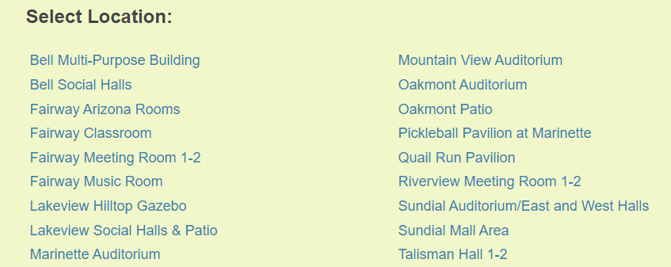
Setup Forms
Master Setup Forms
Due month prior to the event
Club’s Office Sends to Centers and Audio Visual Teams
Notes:
Blank set up forms can be found on the RCSC website or you can have the club office email it to you.
They are due to the center leaders the first week of the month. If you have a meeting in March the setup is due to the center the first week of February so they can plan and schedule.
Understand you might not know the exact numbers this far in advance but if you can look at history or best guess we can update the center with current numbers as we get closer.
If you using the screen and projector, please indicate what type of plug in you have. Most are HDMI.
All setup forms should come to the club office and we will submit to the centers.

Slide 14
Workorder & Budget Request
All repairs to club rooms need to be completed by RCSC staff
Workorders are submitted through the club office
Workorder verses budget request
A work order is for electrical, structural or functional repairs. A budget request is for facility changes, alterations, upgrades and improvements.
Budget request due April 1, 2025
Notes:
2. Please email me what needs repair, and I will put awork order in for you.
I can then track and follow up on the repairs.
If it is an emergency, please connect with the lead custodian.
3. A work order is for electrical, structural or functional repairs. A budget request is for facility changes, alterations, upgrades and improvements.
For example is you want led lighting installed in your club room that is a budget request, if you need a light bulb changed that is a workorder.
4. The budget request due date has been moved up to April 1, 2025. I will be sending out reminders as we get closer. The budget request can be anything the club would like in their room. Even if you do not have dedicated space you can still submit a budget request.
Conclude Board Policy 12 section

Slide 15
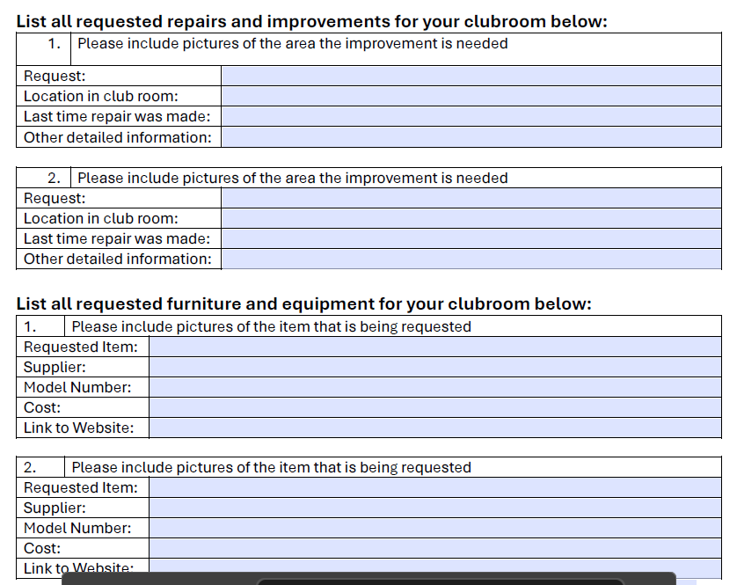

Slide 16
Chartered Clubs - Board Policy 12
Board Policy 12 provides instruction, direction and guidelines regarding operating charter clubs.
It can be found at Suncityaz.org website or the club office can print or email you a copy.

Slide 17
Club Monitors
  Two club monitors during all club operating hours when such tools and equipment are or may be in use
  All clubs requires no less than two (2) persons on site, with at least one person assigned as a monitor while the other must be a member.
  Club rules and policies must contain specific directions that use of RCSC facilities by one (1) person is not allowed and provisions for opening, closing and conducting club activities when applicable
Club Rules & Policies
  Each Chartered Club shall adopt rules and policies, see FORM BP:12-10(a), not in conflict with the Corporate Documents. Clubs must use the mandated rules template which can be found at the Clubs Office or on the RCSC website under Clubs.
  Clubs must consider all provisions of the template and may indicate those provisions as “not applicable” in their rules and policies
  Club rules must be approved by a majority of the club members at a duly notified and called club membership meeting with a quorum present in person.
  Submit rules and policies to the Clubs Office whenever additions, amendments or deletions are made along with the club membership meeting minutes approving such.

Slide 18
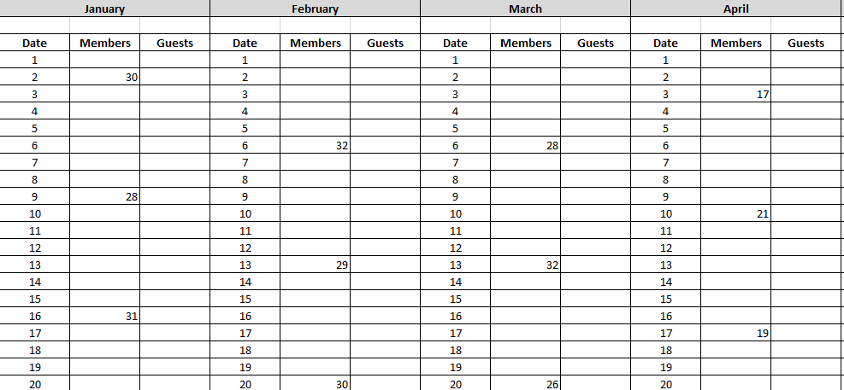
Club Member and Guest Attendance
Notes:
2025 attendance sheet have been sent out. If you did not receive it, please let us know and we will get it sent over to you.
These are due back to the club office the 10th of each month.
This is to track the number of members and guest in the club by day.
We track all the clubs attendance and submit monthly report to the board.
Please do not alter the excel sheet. For example do not add words or delete columns. Each of the attendance sheet for all the clubs feed into a summary sheet and if it is altered we will get an error when opening up the summary sheet. If the club is not meeting in the summer just let us know and we will mark it on a separate sheet we keep.

Slide 19
Club Visitor verses Club Guest
A club visitor is a RCSC cardholder that is not a member of the club
  There are no fees paid to RCSC for club visitors
A club guest is a non RCSC card holder
  Daily guest fee of $2.50 due to RCSC for all guest.
  Guest must enter the club with an active club member.
  Guest are limited to (14) visits per year
Notes:
At this time, there are two ways to submit guest fees. Clubs can purchase a punch card at member services and punch each guest into the club room. A list of the guests name is not required to be submitted to the club office if you go this route.
The other option is to complete the guest register and bring in a check or cash to the club office.
We do realize the guest policy is on the honor system with the unmonitored clubs. If your club is one that has guest that are attending club activities unaccompanied by a member please know that club members do recognize this. We get a few calls a month from club members letting us know this is happening.
We will connect with the president if we do get a call on this.

Slide 20
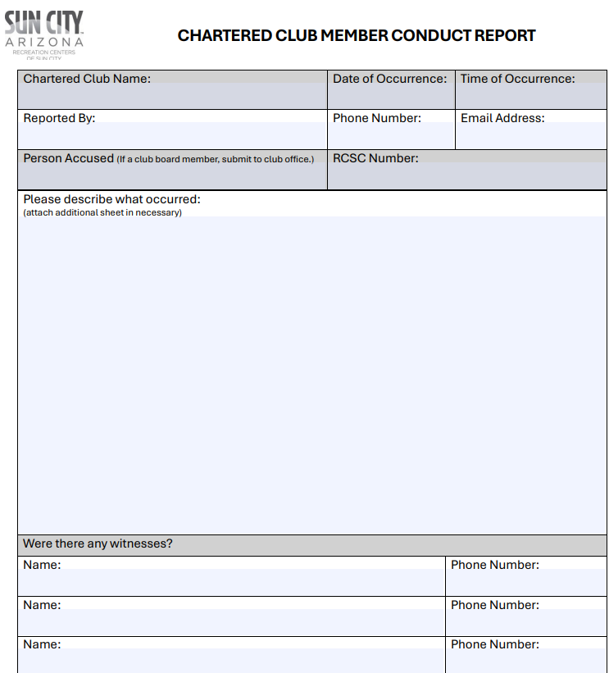
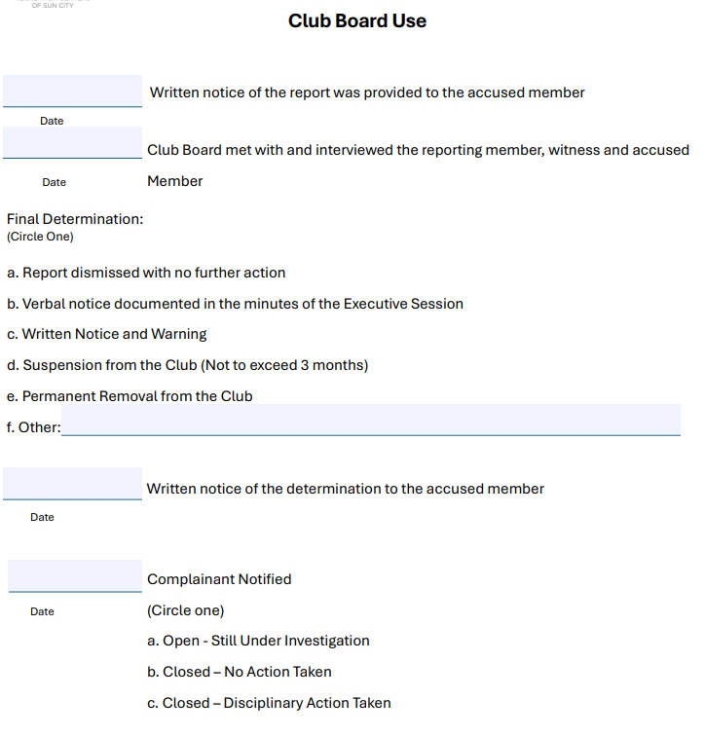
Conduct Reports
Notes:
If you receive a conduct report that is on a member. The club board should handle the report. If you receive a conduct report on a officer, that report gets submitted to the club office where we turn it over to the COC for review. The club should not be handling conduct reports on officers.
Another change to the policy is the club office should be copied on member conduct reports. We will not get involved with club member issue we are simply keeping track of repeat violators.

Slide 21
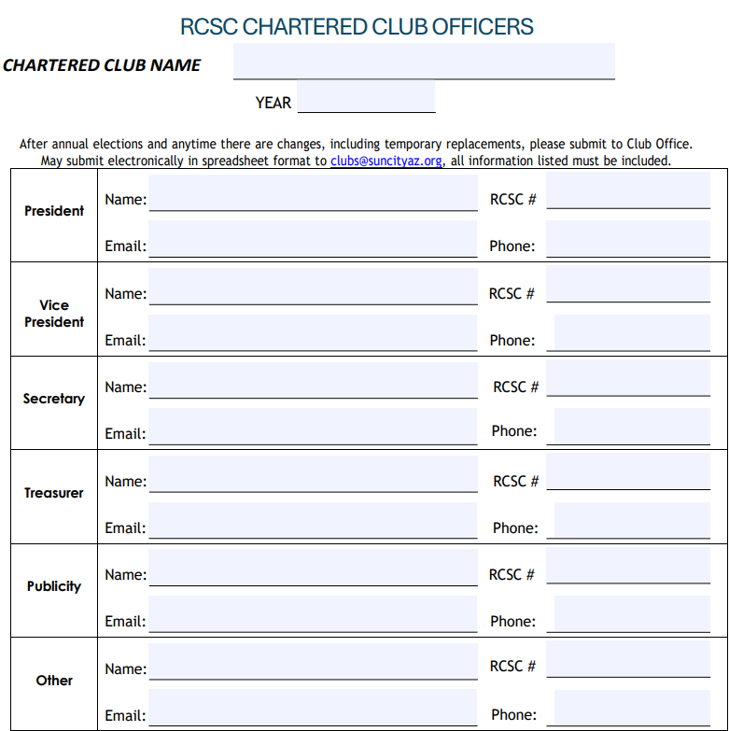
Club Officer Form
Who should be listed?
  Club officers
  Anyone that can make schedule changes
  Anyone that can submit a setup form
  Anyone requesting copies

Slide 22
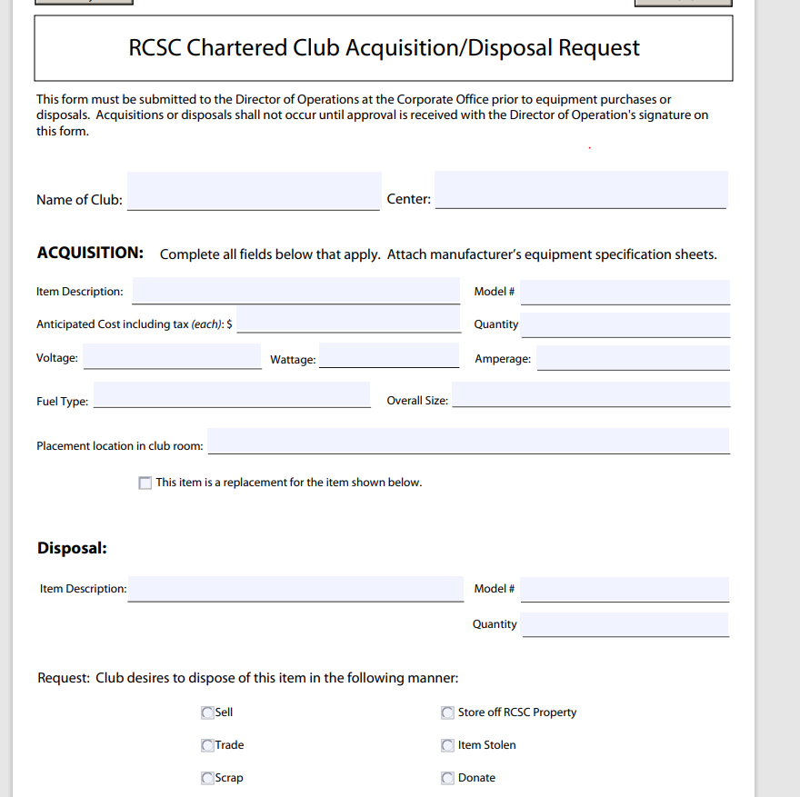
Acquisition or Disposal Form
Notes:
This form is used for Purchasing/Disposing equipment for the club.
For example if your club would like to purchase a white board, you will need to fill this form out. Since the form does not involve power I can sign and return to you.
A different example is if the club is requesting to purchase a sewing machine. I will need to know all the information involving the power (volts, wattage, amperage and so on). The form then will go to the facility department for review. They will give me the yes or no or find out more information. This process can take some time, please be patient
The more information shared on the front end the quicker I can get it signed and returned to you.
The club office tracks the new equipment on the club inventory sheet. We will also remove disposed of equipment from the inventory list.

Slide 23
Other forms
Request for Reciprocal Agreements
-an agreement between two clubs that allows both clubs to enjoy and participate with each other on an equal basis for specific events and dates
Request for a Sanction Event
-an event that the public may attend. A sample of this is quilters show or a concert. Each club can have one sanction event a year. Additional sanction events will incur a rental fee.
Notes:
Reciprocal Agreements – a Reciprocal Agreement is an agreement between two clubs that allows both clubs to enjoy and participate with each other on an equal basis for specific events and dates
For example – the sun city softball team will go and play at sun city grand and sun city grand softball team will play here. It has to be a one for one.
If you have a schedule please submit it with the form. It will be approved faster. I do contact the other facility to confirm they agree to the reciprocal.
Sanction Event – A sanction event is an event that the public may attend. A sample of this is quilters show or a concert. Each club can have one sanction event a year. Additional sanction events will incur a rental fee.
The club that is hosting the sanction event will need to plan and execute the event.

Slide 24
Club Room Safety
Club emergency plan
  Each club should have an emergency plan in place. Always call 911 first before notifying a center associate.
Incident Reports
  Once the person is safely taken care of, an incident report will need to be completed by the all witnesses of the incident.
  Incident reports get submitted to the Safety and Compliance Team to be investigated. These reports are used when there is an injury in the club room, bodily harm done by another member or if you feel threatened.

Slide 25
Club Room Safety
Chemicals
  All clubs must provide Safety Data Sheets (“SDS”) and appropriate posting of all safety documents for all chemicals contained within club.
  The SDS sheets inform users about personal protective equipment required, possible hazards and possible adverse reactions.
  SDS sheets must be kept in a three-ring binder easily accessible to club members and RCSC personnel.
Training
  Members must be trained before they use equipment that is gas, electric, hydraulic, battery, or air powered.
  All training must be documented and retained by the club

Slide 26
Publicity
Copies
  500 a calendar year
  Black ink
  Color paper is available
  Double sided
  Sun City Update
  Directory
  Article – each club gets one article a year
  Digital Boards
  Special Events, Open House, Concert, Spring Sale
  Posted three days prior to your event
  Limited on space short messages
Flyers
  Due the 25th of each month
  9 copies

Slide 27
Contact Information
Club Office
Clubs@suncityaz.org
623-561-4660
Angela Willette
awillette@suncityaz.org
623-561-4664

