Slide 1

990-N Postcard
Please log in to the internet
Network – RCSC Wifi
Password – sunazwifi11

Slide 2
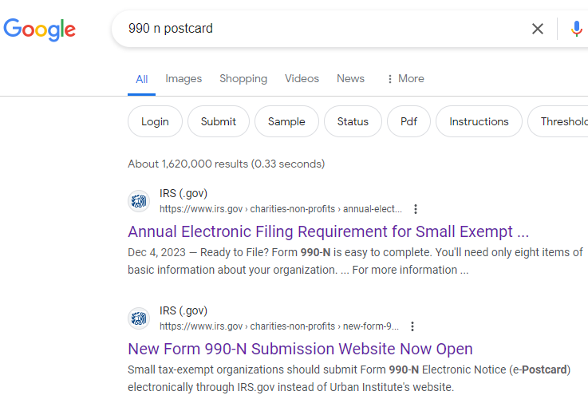

Slide 3
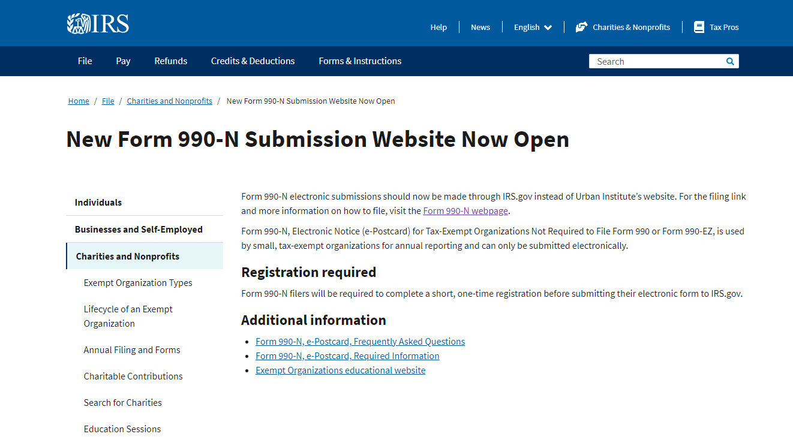

Slide 4
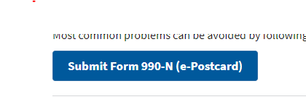
Midway down the page you will find the submit form 990-N

Slide 5
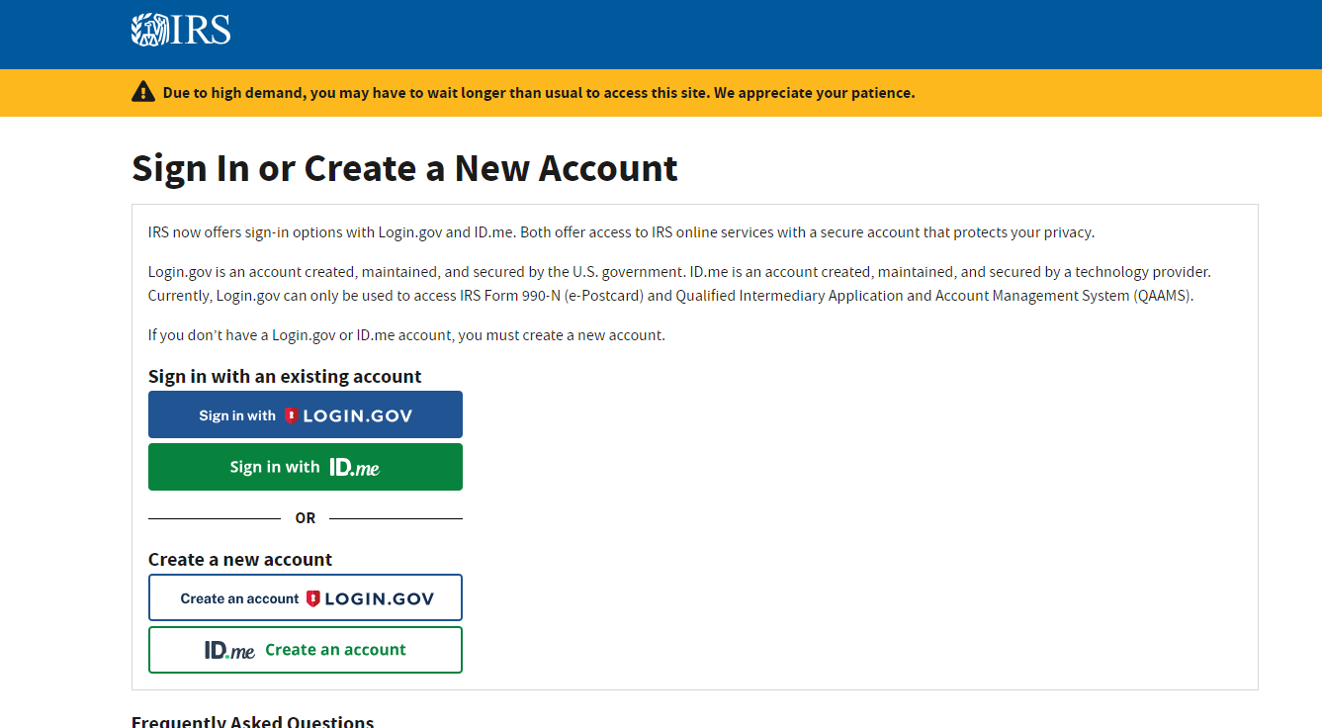

Slide 6
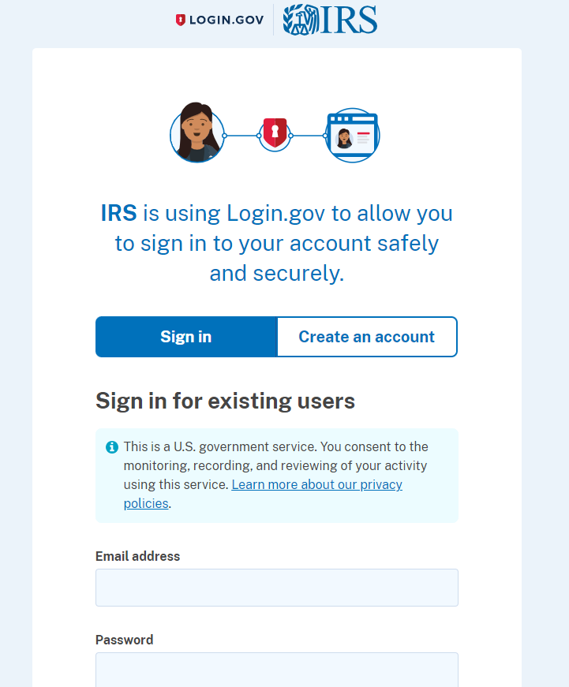
Do you have a sign in with IRS?
Yes, insert your email and password
No, select Create an Account

Slide 7
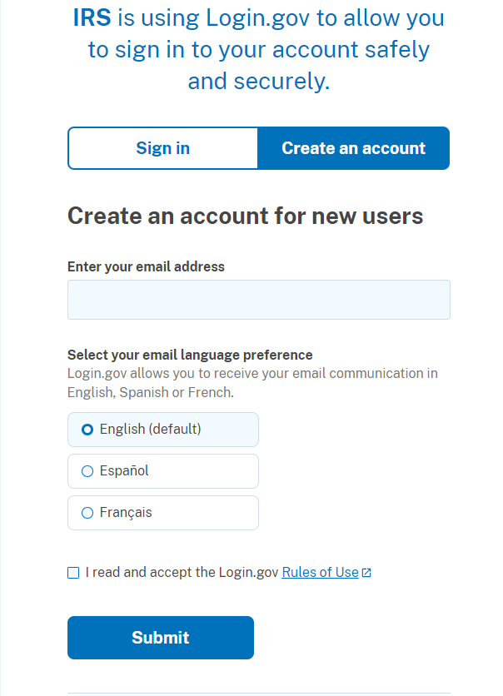
Enter your email address
Select your preferred language
Click the box: I read and accept the login.gov
(take time if needed to review the rules)
Click on Submit

Slide 8
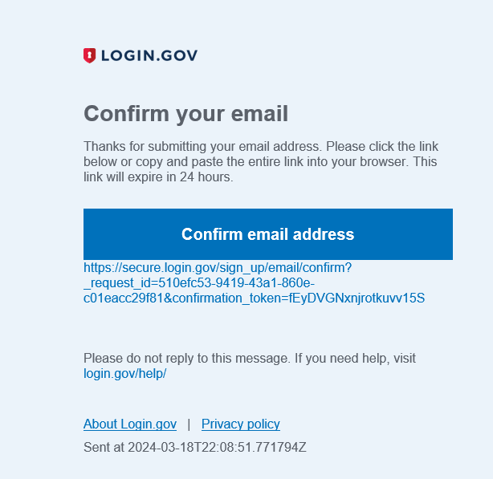
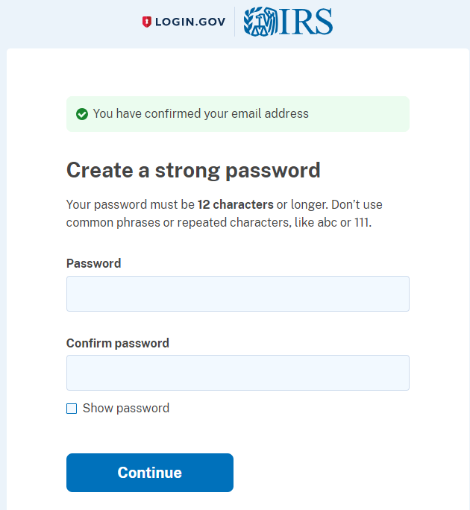
Go to your email
There will be an email from Login.gov

Slide 9
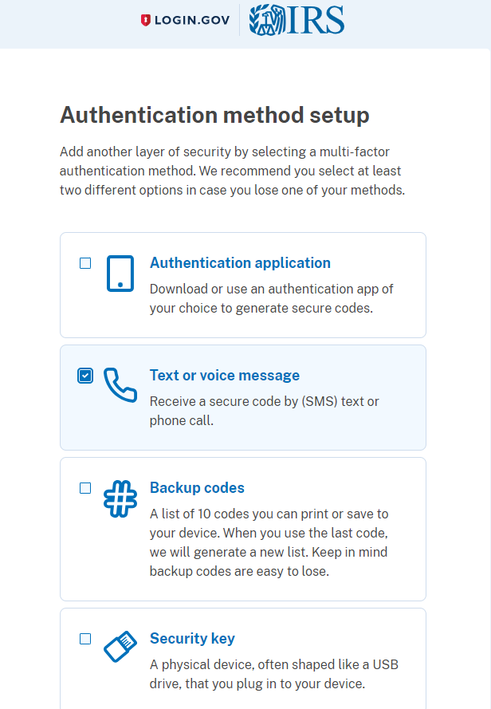
Click receive a text message
Select Continue

Slide 10
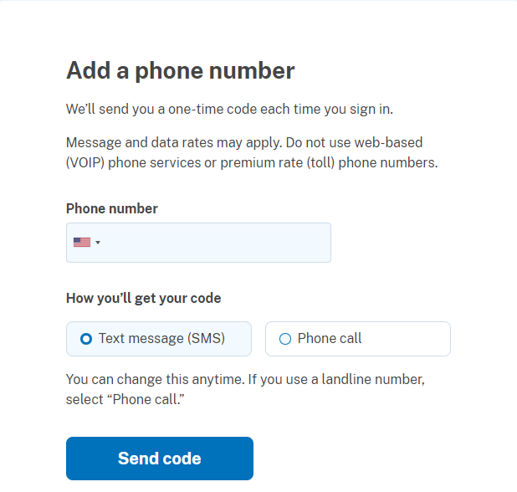
Put in your cell number
Click on Text Message
Click on Send Code

Slide 11
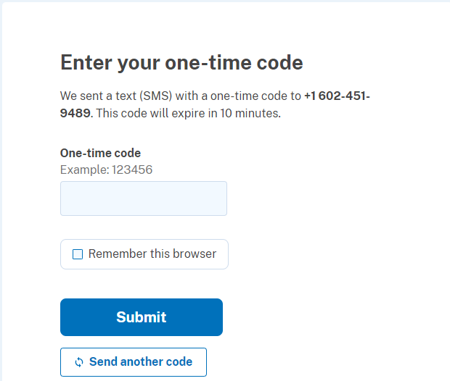
Check your Phone for the code
Enter the code
Do not click on Remember Browser
Click submit

Slide 12
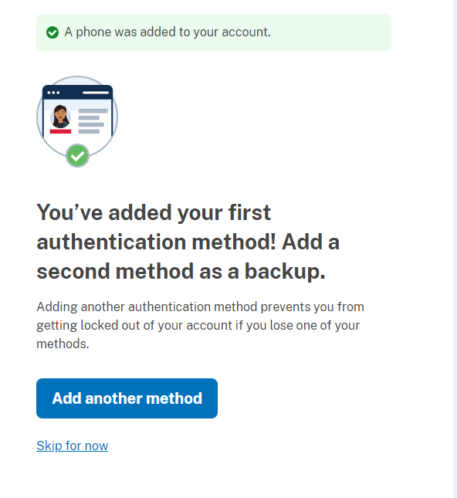
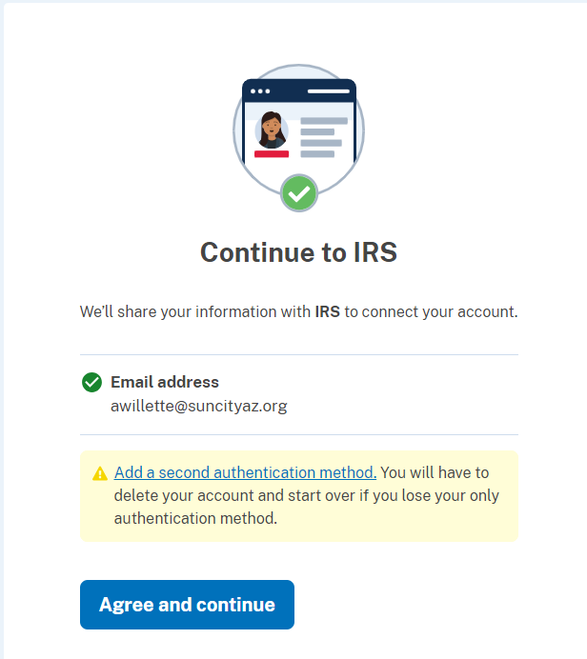

Slide 13
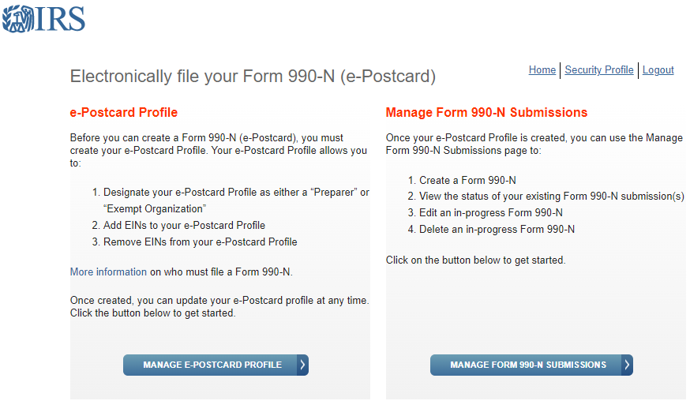

Slide 14
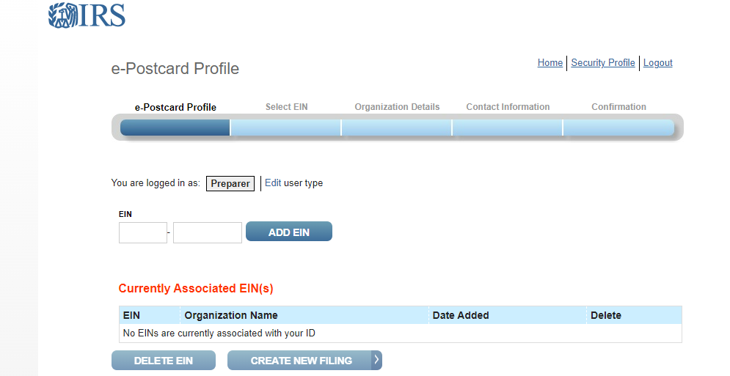

Slide 15
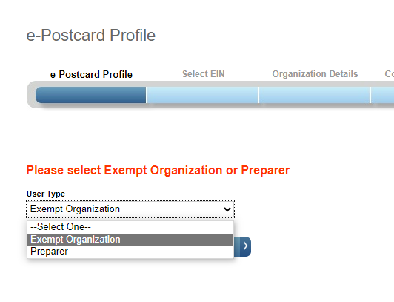
Click on Edit
Use the drop-down arrow to select
EXEMPT ORGANIZATION
Press Continue

Slide 16
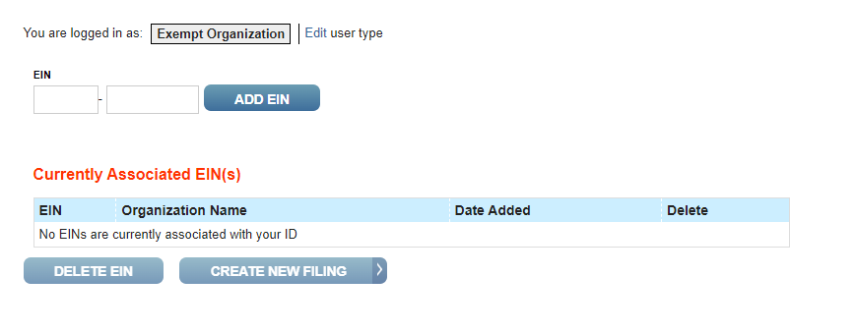
Enter the club ein number
1st Click on ADD EIN
2nd Click on Create New Filing
1st
2nd

Slide 17
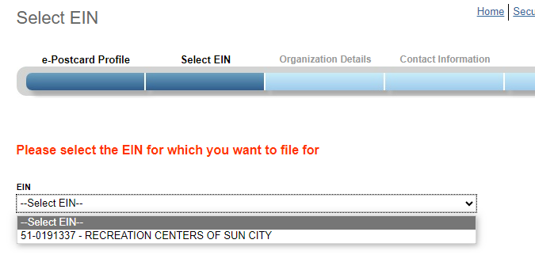
Click the drop-down arrow and select your EIN
Click Continue

Slide 18
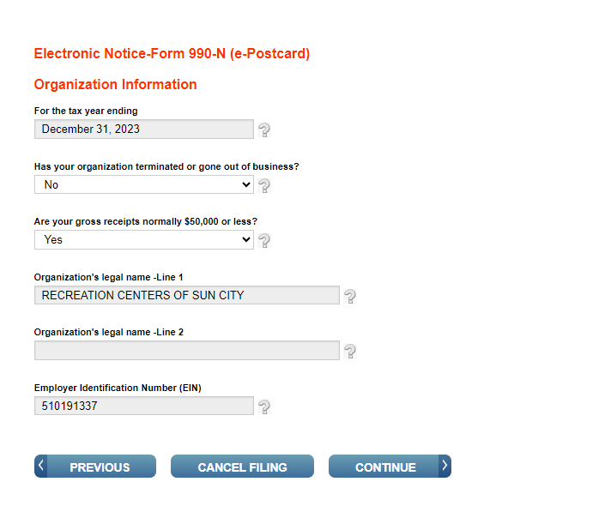
1. December 31, 2023
2. No
3. Yes
Press Continue

Slide 19
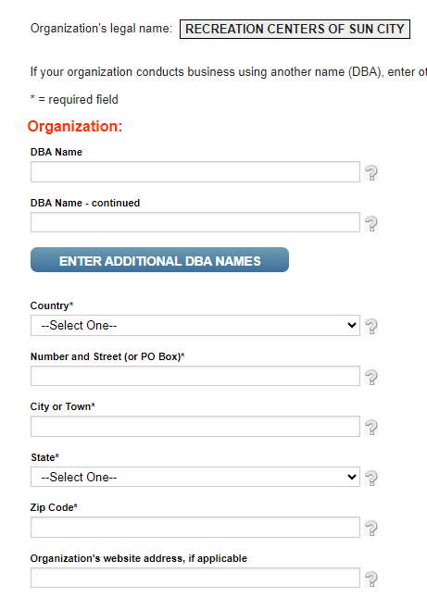
- DBA – Doing Business As
(insert your club name in the first box only leave the second box empty)
Enter Address to Lakeview –
10626 W Thunderbird Blvd
Sun City
85351

Slide 20
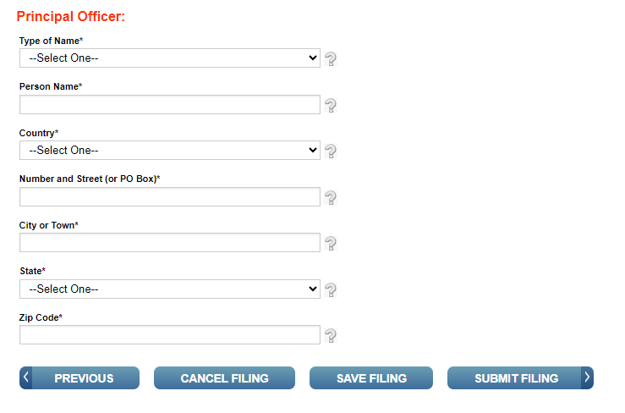
Principal Officer
Select Person
Enter your name or the Club Presidents name
Enter Address to Lakeview
10626 W Thunderbird Blvd
Sun City
85351

Slide 21
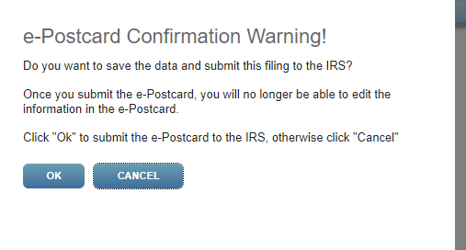
Click OK

Slide 22
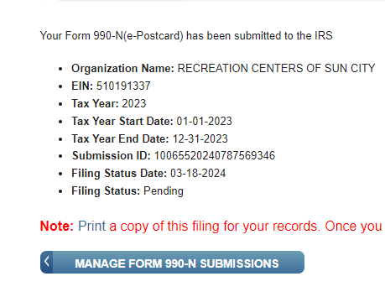
Click on Print
Right Click
Save as – Select Location
Click on Save

